Slide 1
Data Visualization (ctnd): Chapter 11

Slide 2

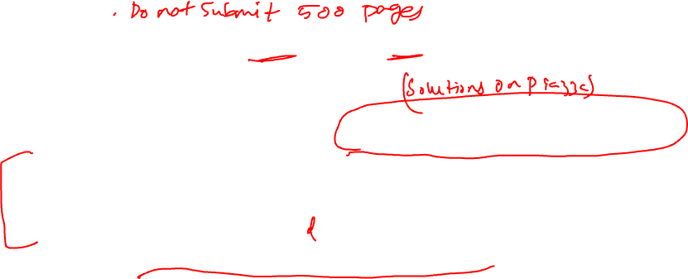
ANNOUNCEMENTS
Homework 1 graded. Solutions are on Piazza. Two weeks for regrade requests
Quiz 1 graded: Mean 13.81, Median: 14.0. Scanned copies of your quizzes with points on Gradescope. You can get hard copies from me. Two weeks for regrade requests
Fill this survey for bonus points: https://forms.gle/m1SBeknqMSkg2HtE9
Project check-in on Gradescope due on 10/10. Late submission is allowed, but please submit on time
Homework 2 will be release tomorrow/Thu, will be due on 10/17. It will be on Visualization and Hypothesis testing

Slide 3
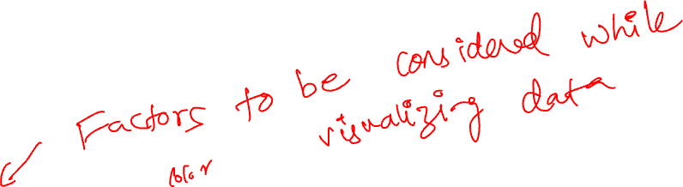
TRANSFORMATIONS
Scale | Conditioning | Perception | Transformation | Context | Smoothing | Philosophy

Slide 4
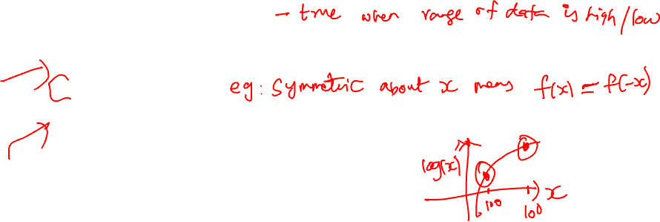
WHY TRANSFORM VARIABLES?
Reveal distribution of most of the observations (otherwise much of the data is squashed in a small region)
Reveal anomalies on the “other side” of the data
Numerical summaries of transformed data are better summaries of a symmetric distribution
Logarithmic transformations are the most common especially when the numbers are large or too small.
Scale | Conditioning | Perception | Transformation | Context | Smoothing | Philosophy

Slide 5
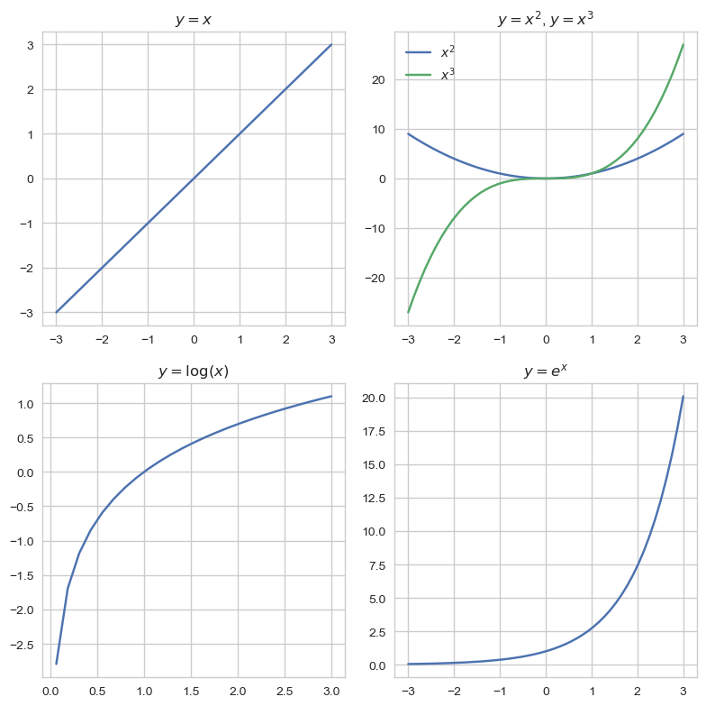
BASIC FUNCTIONAL RELATIONS

Slide 6
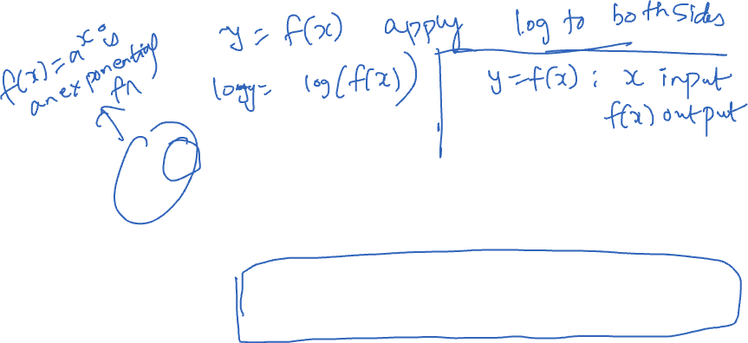
Log transformation: Swiss army knife

Slide 7
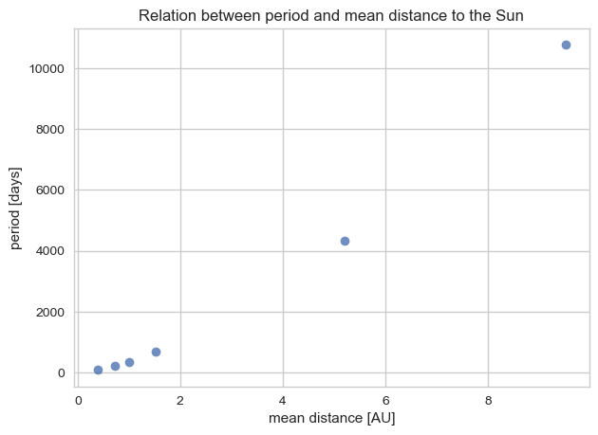
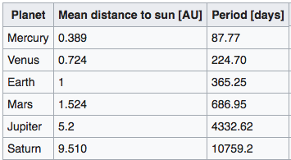
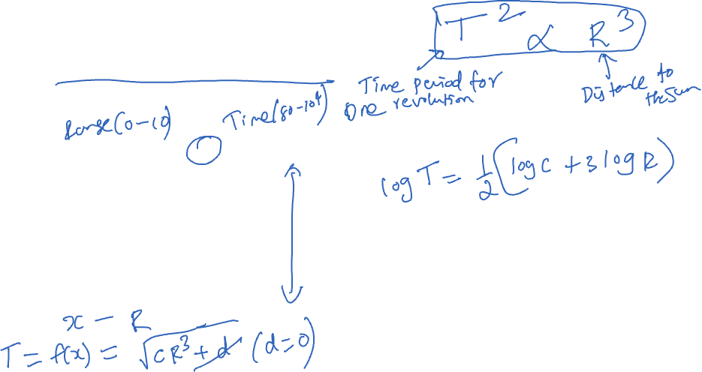
LOGS AND COMPLEX RELATIONS KEPLER’S THIRD LAW (1619)
Scale | Conditioning | Perception | Transformation | Context | Smoothing | Philosophy
Notes:
Transform the data and compute the ratio of the hinges

Slide 8
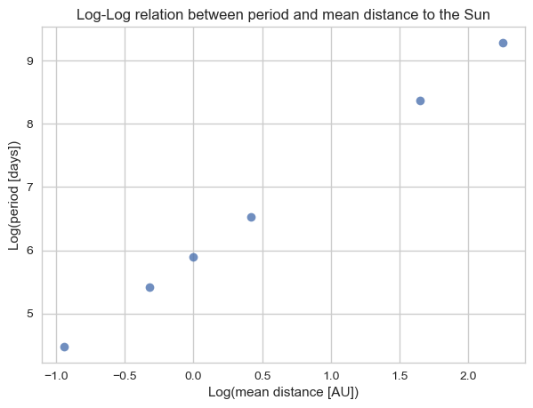
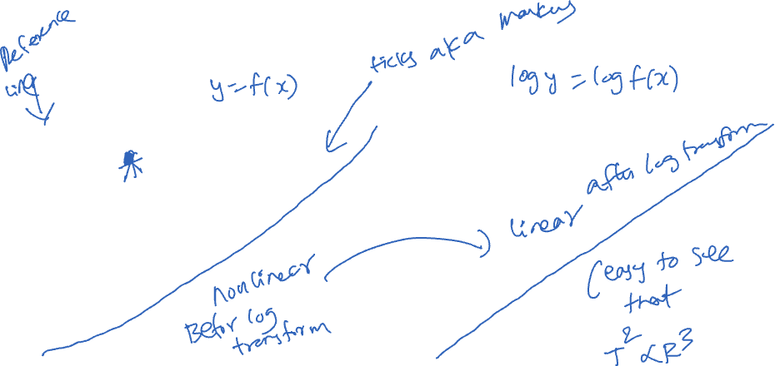
LOGS AND COMPLEX RELATIONS KEPLER’S THIRD LAW
Scale | Conditioning | Perception | Transformation | Context | Smoothing | Philosophy
Notes:
Transform the data and compute the ratio of the hinges

Slide 9
ADD CONTEXT
Scale | Conditioning | Perception | Transformation | Context | Smoothing | Philosophy

Slide 10
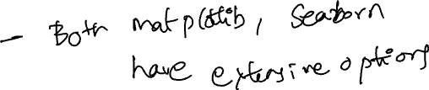
ADD CONTEXT
Label axes, include units
Add Reference lines and markers for important values
Label points of unusual/interesting observations
Include captions that describe data, how plotted, and describe important features
Scale | Conditioning | Perception | Transformation | Context | Smoothing | Philosophy
Notes:
标记轴并注明单位。 添加参考线和标记，用于显示重要值。 标记异常或有趣的观测点。 添加说明文字，描述数据内容、绘制方式以及图中重要特征。

Slide 11
LARGE N (RECORDS) SMOOTHING
Scale | Conditioning | Perception | Transformation | Context | Smoothing | Philosophy

Slide 12
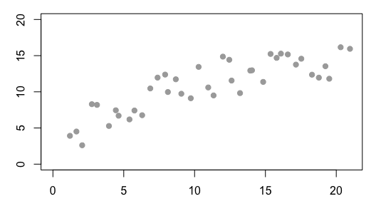
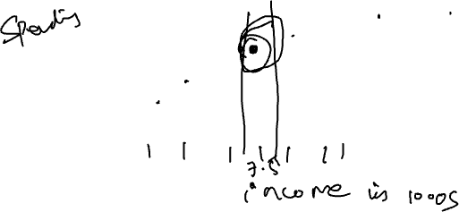
SMOOTHING SCATTER PLOTS
Now we want to smooth the y-values as a function of x

Slide 13
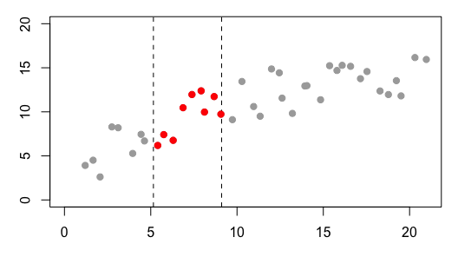
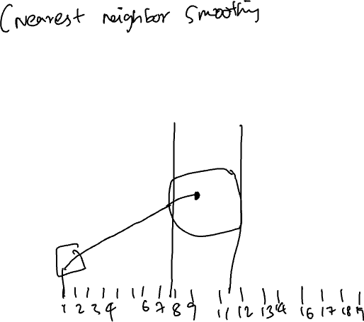
SMOOTHING SCATTER PLOTS
For an x-value
consider all of the x’s near it
Take an average of the y-values

Slide 14
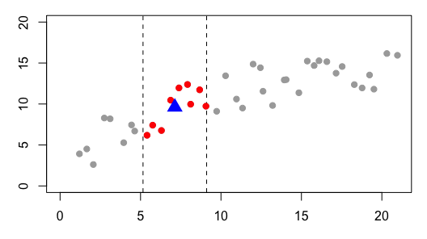
SMOOTHING SCATTER PLOTS
For an x-value
consider all of the x’s near it
Take an average of the y-values

Slide 15
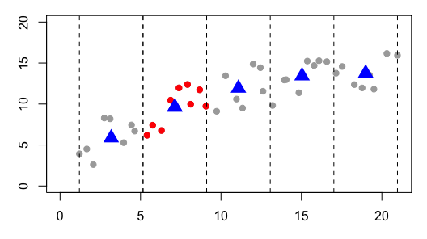
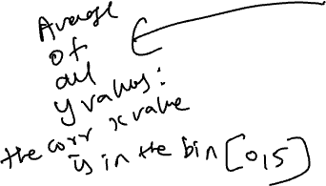
SMOOTHING SCATTER PLOTS
Create bins for all x
Average y-values in each bin

Slide 16
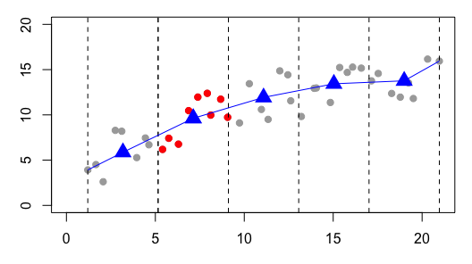
SMOOTHING SCATTER PLOTS
These averages sketch out a curve

Slide 17
SMOOTHING with KERNELS

Slide 18
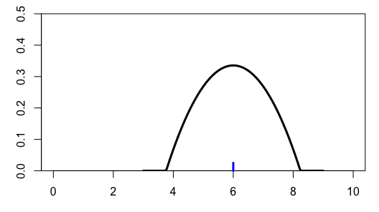
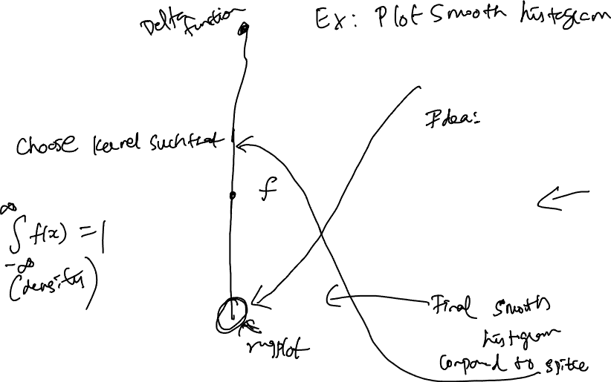
KERNEL DENSITY ESTIMATE: ALTERNATIVE SMOOTHER
Consider one point
Smooth it’s empirical mass with a kernel function,
rather than a histogram bin
Area under this curve is 1
Notes:
Empirical mass 指的是在数据中某个特定点或区域的观测频率或权重，即实际数据分布中的“质量”或“浓度”。在核平滑中，它表示我们要关注的那个点的频率或重要性，不是通过直方图的方式，而是用核函数来平滑地估计这个点的分布密度。

Slide 19
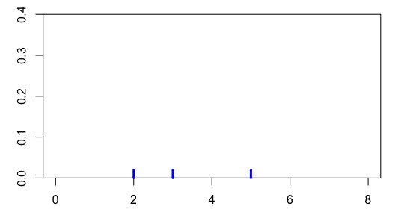
KDE – 3 POINTS

Slide 20
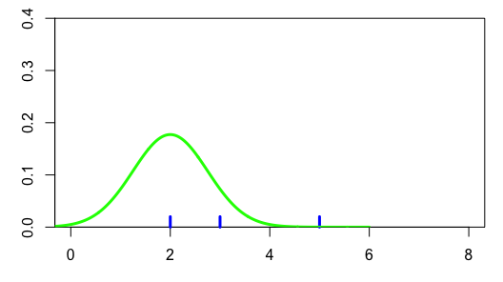

KDE – 3 POINTS
Place a kernel
on each observation

Slide 21
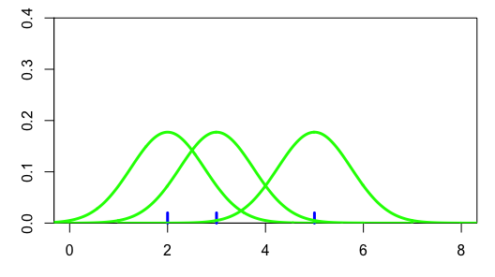
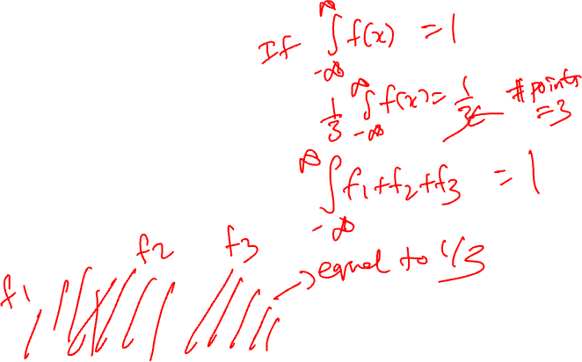
KDE – 3 POINTS
The area under each of the
kernels is 1/3

Slide 22
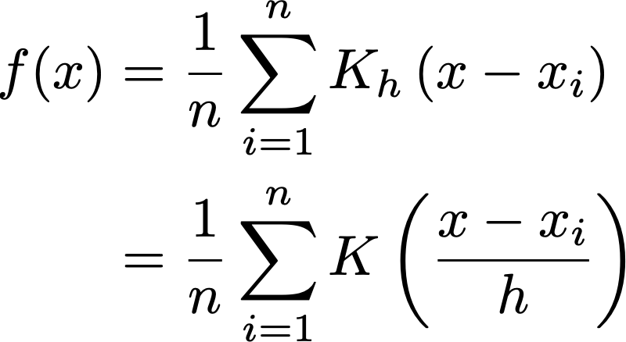
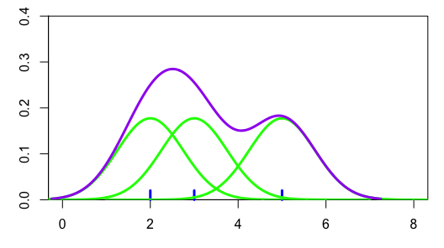
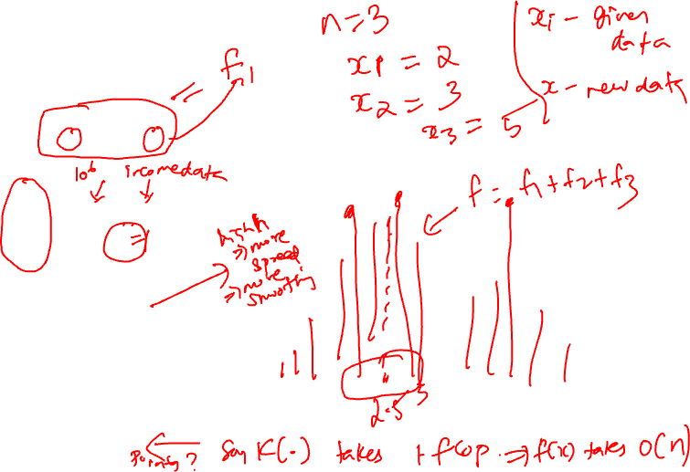
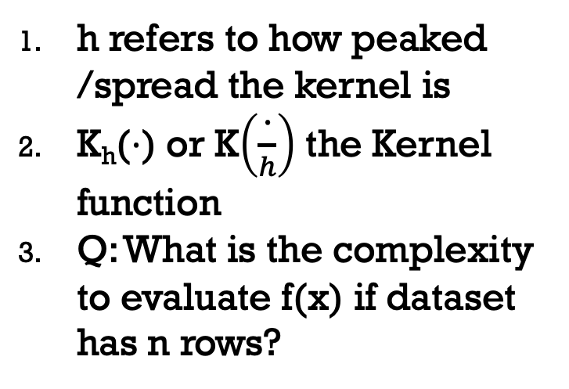
KDE – 3+ POINTS
Sum the 3 kernels at each point to get the density curve
h refers to how peaked /spread the kernel is
K_{h}(⋅) or K$\left(\frac{\text{⋅}}{h}\right)$ the Kernel function
Q: What is the complexity to evaluate f(x) if dataset has n rows?

Slide 23
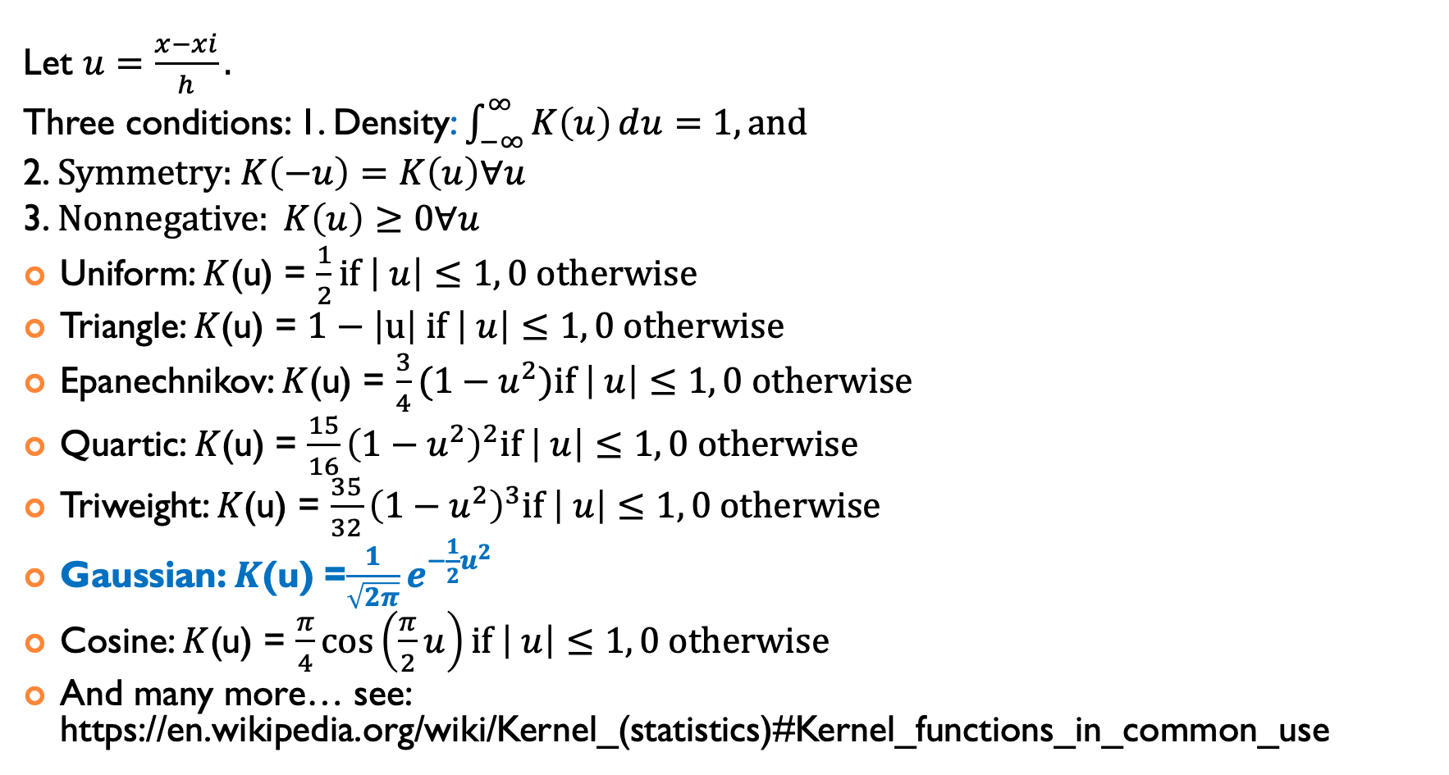
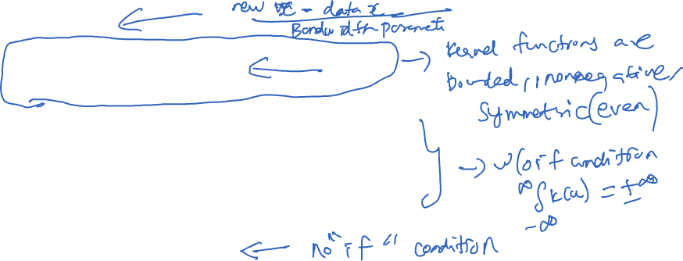
Many Kernels are possible – have to choose based on data
Let $u=\frac{x−xi}{h}.$
Three conditions: 1. Density: $\int_{−∞}^{∞}{K\left(u\right)ⅆu=1, \text{and}}$
2. $\text{Symmetry}\text{:} K\left(−u\right)=K\left(u\right)∀u$
3. $Nonnegative: K\left(u\right)≥0∀u$
Uniform: $K$(u) = $\frac{1}{2}if \left| u\right|≤1, 0 \text{otherwise}$
Triangle: $K$(u) = $1−\left|u\right| if \left| u\right|≤1, 0 \text{otherwise}$
Epanechnikov: $K$(u) = $\frac{3}{4}(1−u^{2})if \left| u\right|≤1, 0 \text{otherwise}$
Quartic: $K$(u) = $\frac{15}{16}{\left(1−u^{2}\right)}^{2}if \left| u\right|≤1, 0 \text{otherwise}$
Triweight: $K$(u) = $\frac{35}{32}{\left(1−u^{2}\right)}^{3}if \left| u\right|≤1, 0 \text{otherwise}$
Gaussian: $K$(u) =$\frac{1}{\sqrt{2π}}e^{−\frac{1}{2}u^{2}}$
Cosine: $K$(u) = $\frac{π}{4}\cos\left(\frac{π}{2}u\right)if \left| u\right|≤1, 0 \text{otherwise}$
And many more… see: https://en.wikipedia.org/wiki/Kernel_(statistics)#Kernel_functions_in_common_use
Notes:
密度条件：核函数的积分应该等于1，以保证估计的总密度为1，即
∫−∞∞K(u) du=1.\int_{-\infty}^{\infty} K(u) \, \mathrm{d}u = 1.∫−∞∞​K(u)du=1.对称性：核函数 K(u)K(u)K(u) 对于 u=0u = 0u=0 是对称的，满足 K(−u)=K(u)K(-u) = K(u)K(−u)=K(u) 对于所有 uuu 成立。这确保了核的平滑效果对数据左右两侧一致。
非负性：核函数 K(u)K(u)K(u) 必须是非负的，即 K(u)≥0K(u) \geq 0K(u)≥0 对于所有 uuu 成立。这意味着密度估计不会出现负值。

Slide 24
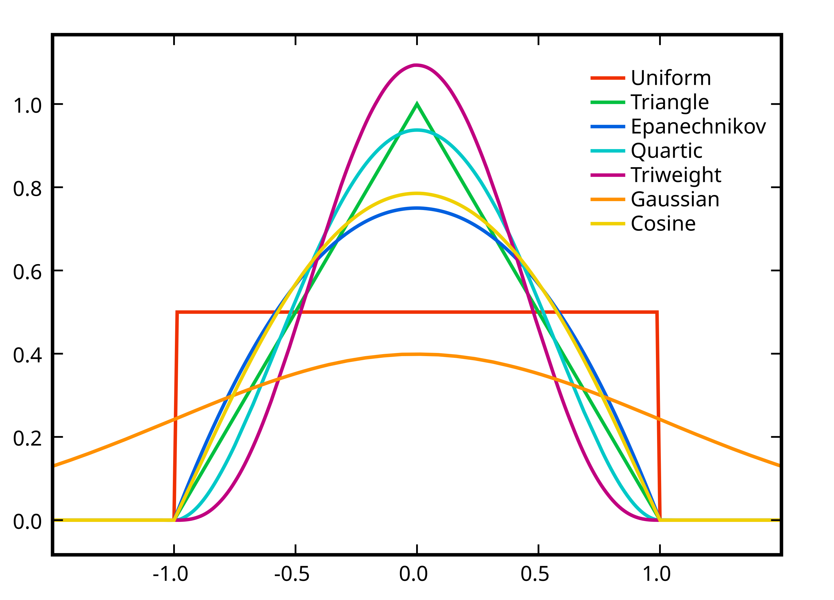

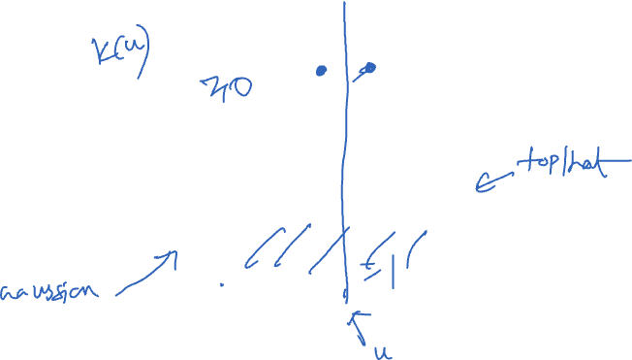
Many Kernels are possible – have to choose based on data
Let $u=\frac{x−xi}{h}$
Uniform: $K$(u) = $\frac{1}{2}if \left| u\right|≤1, 0 \text{otherwise}$
Triangle: $K$(u) = $1−\left|u\right| if \left| u\right|≤1, 0 \text{otherwise}$
Epanechnikov: $K$(u) = $\frac{3}{4}(1−u^{2})if \left| u\right|≤1, 0 \text{otherwise}$
Quartic: $K$(u) = $\frac{15}{16}{\left(1−u^{2}\right)}^{2}if \left| u\right|≤1, 0 \text{otherwise}$
Triweight: $K$(u) = $\frac{35}{32}{\left(1−u^{2}\right)}^{3}if \left| u\right|≤1, 0 \text{otherwise}$
Gaussian: $K$(u) =$\frac{1}{\sqrt{2π}}e^{−\frac{1}{2}u^{2}}$
Cosine: $K$(u) = $\frac{π}{4}\cos\left(\frac{π}{2}u\right)if \left| u\right|≤1, 0 \text{otherwise}$
And many more…
See: https://en.wikipedia.org/wiki/Kernel_(statistics)#Kernel_functions_in_common_use

Slide 25
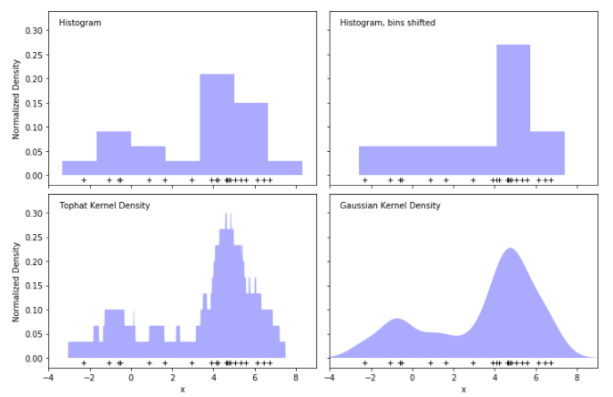
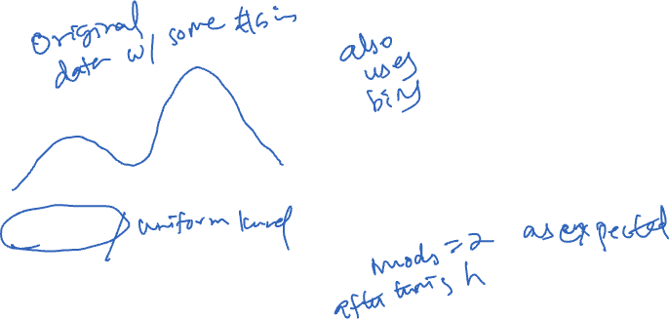
http://scikit-learn.org/stable/modules/density.html

Slide 26
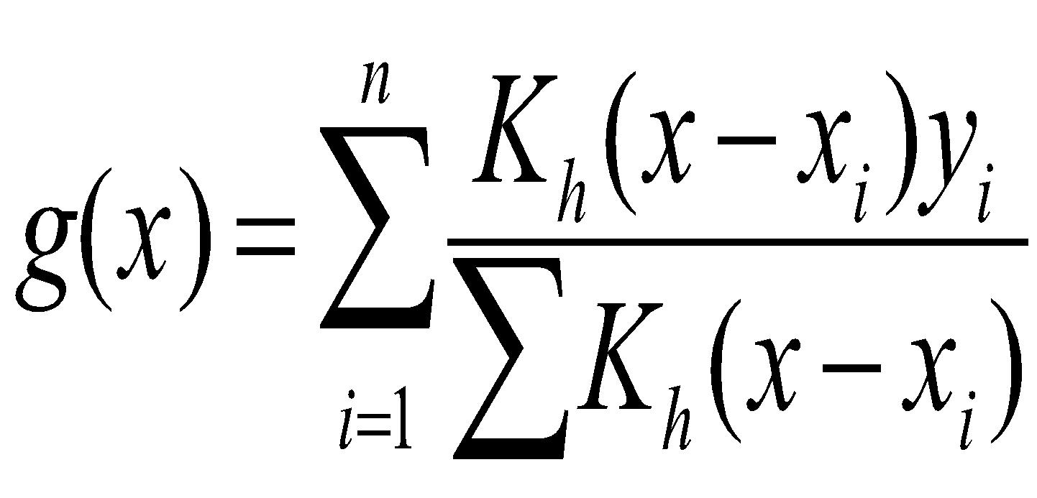
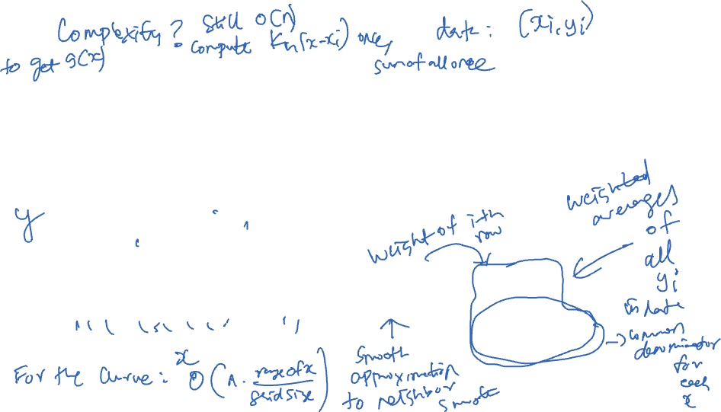
SMOOTHING SCATTER PLOTS
Rather than a simple average in fixed bins
We use kernels positioned on the x_{i} to determine the weights to place on the y_{i} in the average
The denominator ensures the weights sum to 1

Slide 27
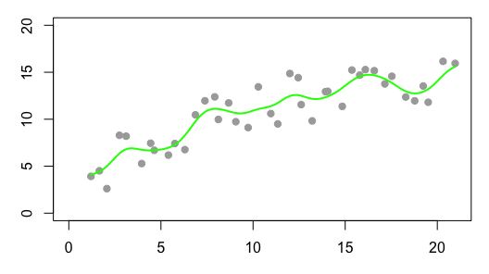

SMOOTHING SCATTER PLOTS
Rather than a simple average
We use kernels positioned on the x_{i} to determine the weights to place on the y_{i} in the average
The denominator ensures the weights sum to 1

Slide 28
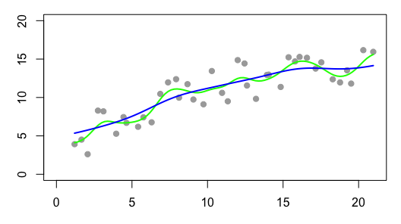
SMOOTHING SCATTER PLOTS
For each x, we find g(x) by a weighted average of the y_{i}
The y_{i} are weighted according to the kernel function.
So x_{i} far from x do not contribute much to g(x)

Slide 29
LOCAL SMOOTHING
Moving window
Smooth/Average y values in the window
Many different approaches for doing this:
kernel methods (what we just showed),
cubic splines, thin plate splines,
Locally weighted smooth scatterplot (lowess)
Allows us to see shape of the relationship between y and x
Scale | Conditioning | Perception | Transformation | Context | Smoothing | Philosophy

Slide 30
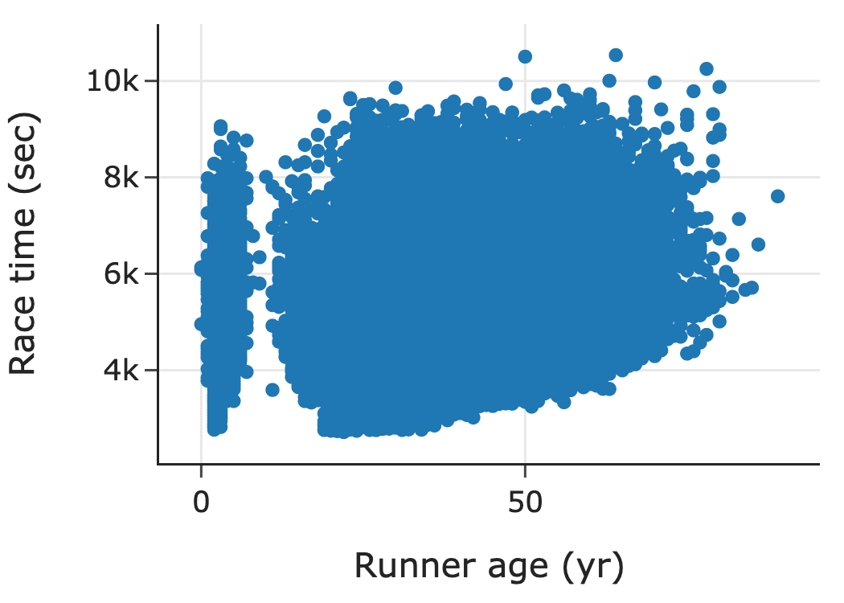
CHERRY BLOSSOM RUN
3-dimensional histogram is needed, but hard to come by
Use heat map or hexbin plot or transparency or contour plot
Make a smooth curve that takes local averages to see the conditional center, i.e., average y in a neighborhood of x
Scale | Conditioning | Perception | Transformation | Context | Smoothing | Philosophy
Notes:
3D 直方图虽然在展示数据分布的三维关系时很有用，但通常难以实现。可以使用以下替代方法来展示复杂的分布关系：
热图 (Heat Map)：通过颜色表示数据密度，颜色越深表示密度越高，用于展示 x 和 y 之间的关系。
六边形图 (Hexbin Plot)：用六边形网格代替传统的直方图的矩形分箱，更有效地展示二维数据的密度分布。
透明度：使用透明度（alpha 值）来叠加多个数据点，减少重叠导致的信息丢失。
等高线图 (Contour Plot)：用等高线表示密度变化，可以直观地显示高密度区域。

Slide 31
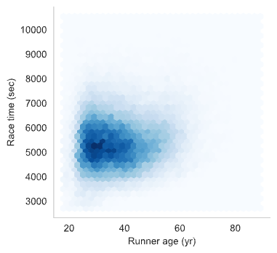
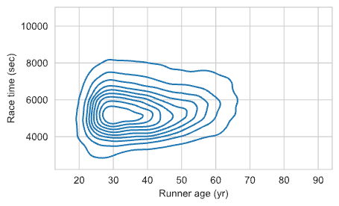
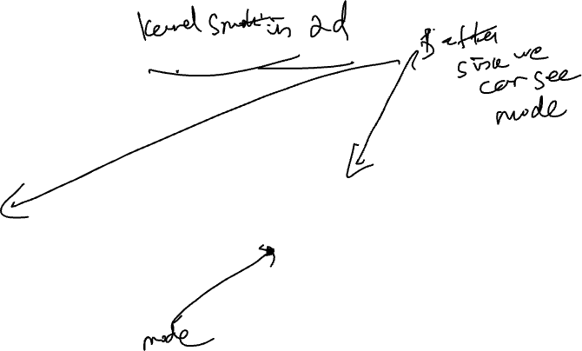
CHERRY BLOSSOM RUN
Scale | Conditioning | Perception | Transformation | Context | Smoothing | Philosophy

Slide 32
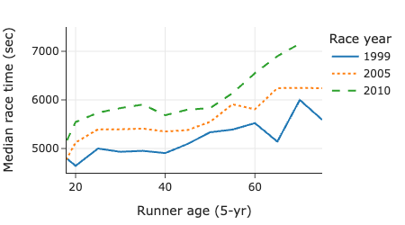
CHERRY BLOSSOM RUN
Local Smoothing helps us see the typical run time for each age
We have controlled for year by making separate smooth curves for runners in each yearly race
Notice anything unusual?
Scale | Conditioning | Perception | Transformation | Context | Smoothing | Philosophy

Slide 33
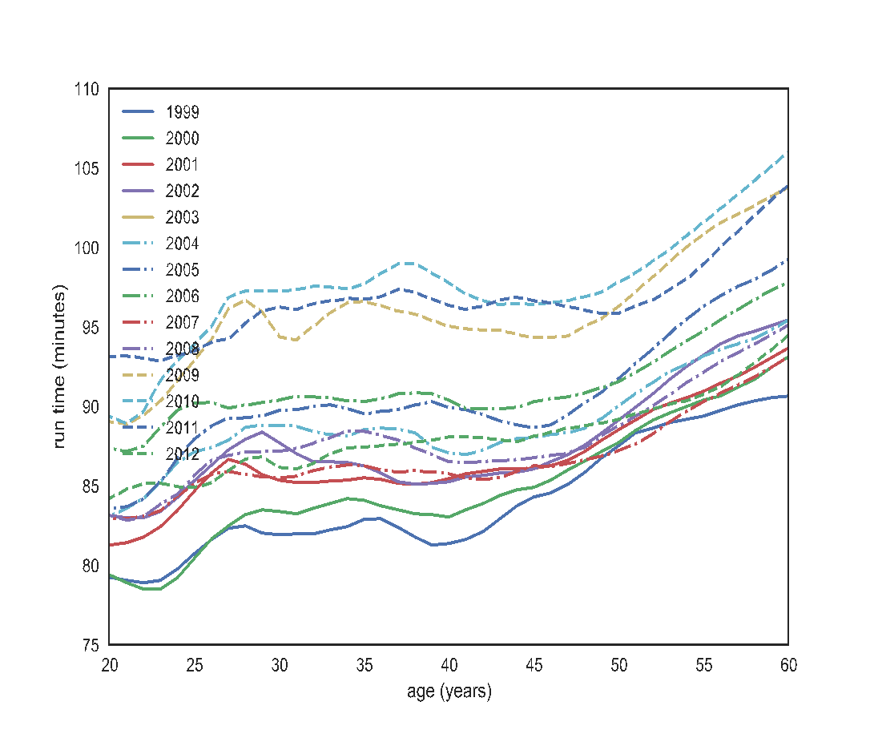
CHERRY BLOSSOM RUN
How are the data generated?
All runners in each annual CB run from 1999 to 2012
Snapshots in time – one for each year – Runners in 1999 may be quite different than runners in 2012
If we control for year and only examine the relationship between time and age for 2012, we still have a problem. These are not longitudinal data where we follow the same people in time as they age.
Scale | Conditioning | Perception | Transformation | Context | Smoothing | Philosophy
Notes:
This is NOT a longitudinal study! LS is a continued acquisition of data on the SAME PEOPLE.
Here, we’re not following the same people. We have different people of different ages at different points in time.
The race became very popular, so

Slide 34
PHILOSOPHY
Scale | Conditioning | Perception | Transformation | Context | Smoothing | Philosophy

Slide 35
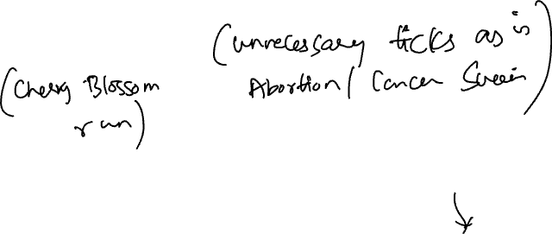
REVEAL THE DATA
Choose scale appropriately
Avoid having other graph elements interfere with data
Use visually prominent symbols
Eliminate superfluous material, aka chart junk
Avoid over-plotting
Scale | Conditioning | Perception | Transformation | Context | Smoothing | Philosophy
Notes:
选择合适的刻度：确保刻度反映数据的真实分布和范围，避免误导。
避免图表元素干扰数据：尽量减少会分散注意力的元素，使数据成为视觉的焦点。
使用显眼的符号：确保数据点或数据线在图表上清晰易见。
消除多余的材料（也称为图表垃圾）：删除不必要的装饰元素，如过多的背景线条、边框、复杂的颜色等，简化图表。
避免过度绘制：如果数据点太多导致图表混乱，可以选择透明度调整、抽样或使用其他视觉化方式，避免信息重叠导致难以辨认。
这一哲学旨在通过简洁、清晰的设计最大化图表的可读性和信息传达效果。

Slide 36
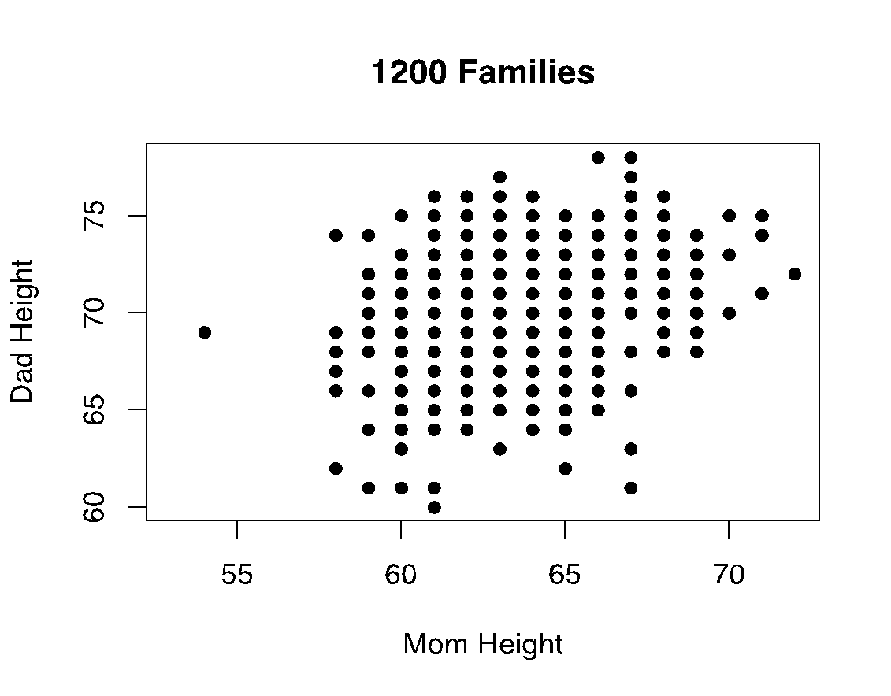
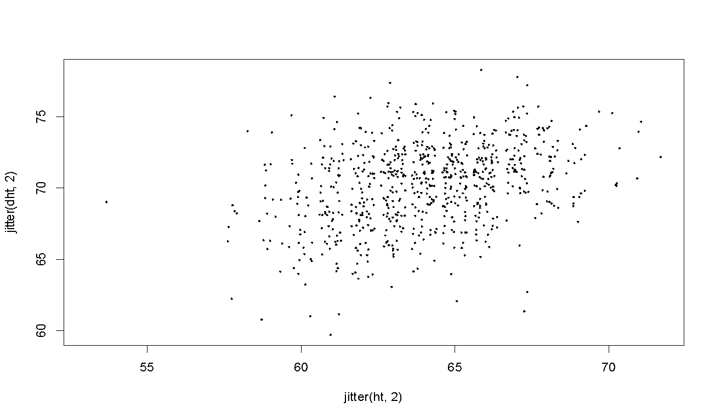
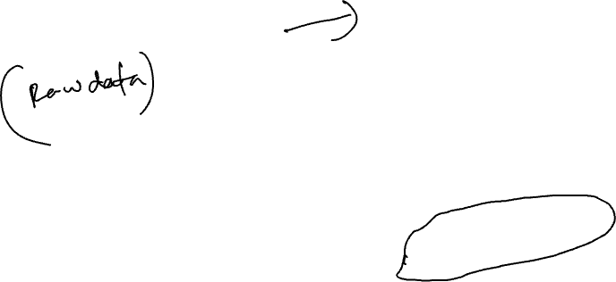
AVOID OVER-PLOTTING
Jitter: Add random noise so the values aren’t plotted on top of each other
Why are there so few data points?
Shrink the plotting symbol so they don’t plot on top of each other
Scale | Conditioning | Perception | Transformation | Context | Smoothing | Philosophy
Notes:
1.Add random noise 2. Shrink the plotting symbol

Slide 37

FACILITATE COMPARISONS
Put Juxtaposed plots on same scale
Make it easy to distinguish elements of superposed plots, e.g. with color, line type
Avoid Stacking and Jiggling the baseline
Avoid angles, extra dimensions (e.g., areas rather than lines)
Don’t break the visual metaphor, i.e., if use rectangles, then area should correspond to value
Scale | Conditioning | Perception | Transformation | Context | Smoothing | Philosophy
Notes:
保持并排图表的相同刻度：确保并排展示的图表使用相同的刻度，以便轻松比较不同图表之间的数据。
区分重叠图表的元素：使用颜色或线型等方式，帮助区分叠加在一起的图表元素，使每个图表的元素易于识别。
避免堆叠和基线抖动：避免图表中的数据基线在各元素之间上下移动，因为这会让数据难以准确解读。
避免使用角度或额外维度：如无必要，避免使用角度或额外的维度（如面积）来表示数据，直接使用线条或条形更为直观。
保持视觉隐喻一致：例如，如果使用矩形来展示数据，那么矩形的面积应与数据值成比例，以便用户能够正确解读数据大小。

Slide 38

MAKE A PLOT INFORMATION RICH
Describe what you see in the Caption
Add context with Reference Markers (lines and points) including text
Add Legends and Labels
Use color and plotting symbols to add more information
Plot the same thing more than once in different ways/scales
Reduce clutter
Scale | Conditioning | Perception | Transformation | Context | Smoothing | Philosophy
Notes:
描述图表的内容：在图表的标题或说明中简要描述所展示的数据内容，让观众快速了解图表的主题。
添加参考标记：使用参考线和标记点来提供上下文信息，比如显示重要的数值或目标点，并在旁边添加文字解释，帮助观众理解数据的意义。
添加图例和标签：在图表中加入图例和标签，使数据来源、变量和颜色对应的含义清晰明了，增加数据的可读性。
使用颜色和符号丰富信息：通过颜色和不同的图形符号来区分不同的数据类别或变量，让图表内容更具信息量。
多种展示同一数据：可以采用不同的展示方式或刻度展示同一数据，以便观众从多个角度理解数据。
减少杂乱：尽量去除不必要的装饰和元素，让图表更加简洁，帮助观众专注于数据本身。

Slide 39
CAPTIONS 标题
Captions should be comprehensive
Self-contained
Captions should:
Describe what has been graphed
Draw attention to important features
Describe conclusions drawn from graph
Scale | Conditioning | Perception | Transformation | Context | Smoothing | Philosophy

